Slide 1
It is better to go to a house of mourning than to go to a house of feasting, for death is the destiny of everyone; the living should take this to heart.
Ecclesiastes 7:2
Notes:
Welcome. This is a talk about AI agents for security work. Not ChatGPT tips. Not 'AI will replace you.' Not ethics philosophy. This is about the tools that are working right now — some of which the US government is so scared of they imposed export controls. We're going to cover what they are, how they work, and how to use them — whether you're the one testing the fence or the one building it. The raptors in Jurassic Park didn't escape because they were smart. They escaped because they were *trained*. Let's talk about training.

Slide 2

Clever Girl
Teaching AI Agents to Hunt Like a Hacker
GrrCON 2026 • September 2026
"They tested the fences for weaknesses. Systematically." — Jurassic Park
atlas0fd00m • Hacker • RE Engineer • AI Agent Wrangler
Notes:
Welcome. This is a talk about AI agents for security work. Not ChatGPT tips. Not 'AI will replace you.' Not ethics philosophy. This is about the tools that are working right now — some of which the US government is so scared of they imposed export controls. We're going to cover what they are, how they work, and how to use them — whether you're the one testing the fence or the one building it. The raptors in Jurassic Park didn't escape because they were smart. They escaped because they were *trained*. Let's talk about training.

Slide 3

— Muldoon's last words, right before the raptor
that had been learning his patterns outflanked him.
Notes:
This is the thesis of the talk in two words. The raptors didn't break out through brute force. They tested the electric fences systematically. They learned the patterns. They found the weaknesses. And they exploited them. That's exactly what AI agents do when you build them for security work. They don't think. They pattern-match at a scale no human can match, and they never get bored. The question isn't whether to use them. The question is whether you'll be Muldoon — the expert who got outflanked because he underestimated what the raptors had learned — or the one holding the controller.

Slide 4
Where We Are: The AI Security Landscape
Mar 2026
Claude Mythos leaks — Anthropic's cybersecurity supermodel
Apr 2026
Project Glasswing — 40+ companies get access to find vulns
Apr 2026
US government imposes export controls on Mythos
Jun 2026
Fable 5 released (Mythos with a muzzle) → export controls → lifted
Jun 2026
Sakana Fugu launches from Japan — multi-agent orchestration
Jul 2026
Fable 5 made standard on Anthropic's higher-tier plans
Aug 2026
DeepSeek V4-Flash (284B MoE, 1M ctx) + Qwen3.8-27B released
Notes:
Let me set the stage. In the last five months, the AI security landscape has changed more than in the previous five years. Anthropic built a model so good at finding vulnerabilities that the US government classified it. They then released a muzzled version called Fable 5. Meanwhile, a Japanese company called Sakana AI built a system that orchestrates the world's best models into a single API — specifically designed to route around export controls. And just this month, DeepSeek V4-Flash and Qwen3.8-27B dropped — open-weight models with 1M token context that run on consumer hardware. This is the world we're operating in now. These aren't hypothetical tools. They're being used right now.

Slide 5
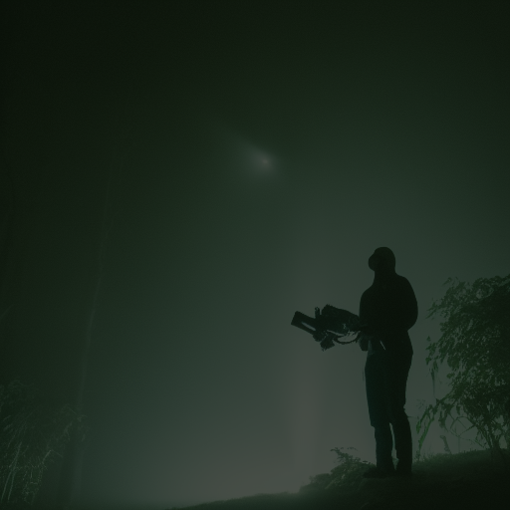
Who This Talk Is For
RED TEAM / OFFENSIVE
BLUE TEAM / DEFENSIVE
• RE, exploit dev, pentesting
• Can agents find bugs faster?
• Can agents write exploits?
• Can agents do RE autonomously?
"I want agents that hunt."
• SOC, IR, malware analysis
• Can agents triage alerts at 2 AM?
• Can agents analyze malware?
• Can agents correlate threat intel?
"I want agents that defend."
The answer to all of these is yes. Same architecture. Same tools.
Notes:
This talk serves both crowds. If you're offensive — you want to know if agents can do RE, find bugs, and write exploits. If you're defensive — you want to know if agents can triage your alerts, analyze malware, and correlate threat intel. The answer to all of these is the same: yes. And here's the key insight: the same agent architecture powers both. The raptors don't care which side of the fence they're on. They just hunt.

Slide 6
02
Understanding the Predators
Notes:
Now let's talk about what these models actually are — and the three new apex predators that changed everything this year.

Slide 7

What Is an LLM? (Fast Version)
The 30-second explanation:
• An LLM = a probability distribution over tokens
• It guesses the next word. Repeatedly. Very fast.
• Training: show it the internet + all code + all CVEs
• Inference: running the model to generate text
It doesn't think. It pattern-matches at massive scale.
Key insight for hackers:
The model has seen every CVE, every exploit,
every RE tutorial ever published.
The skill is extracting that knowledge.
$ ollama run qwen3.8-27b
> What is a stack buffer overflow?
# It's that easy. The model knows.
Notes:
Fast version — you're practitioners, not students. An LLM is a probability engine. It's seen every CVE, every exploit writeup, every RE tutorial, every security paper ever published. It doesn't *know* anything. It pattern-matches. Your job is to extract the knowledge with the right questions and the right workflow. The model is the raptor. You're the handler.

Slide 8
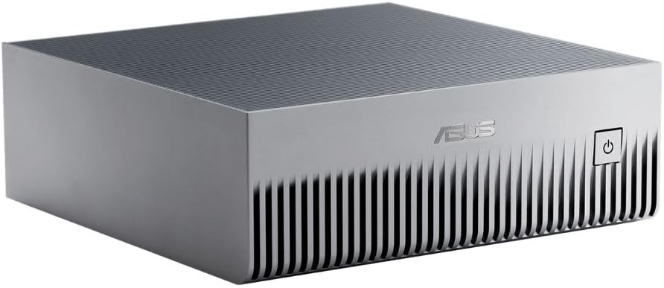
The "B" in 27B — And the T in 8T
Size | Examples | Hardware | Use Case
7-14B | Gemma4, Phi-4 | Any laptop | Summarization, simple code
27B (dense) | Qwen3.8-27B, Gemma4 27B | 1x 24GB GPU (Q4) | Solid RE, coding, agentic — multimodal
27-72B | Qwen 3.6 32B, Llama 4 | 1x 24GB GPU (Q4) | Solid RE, decent code
284B (MoE) | DeepSeek V4-Flash | DGX Spark / 2x 3090 (Q4) | Near frontier, 1M context
1.6T (MoE) | DeepSeek V4-Pro | Multi-GPU / API | Frontier-class, 1M context
~5T | Claude Fable 5 | Datacenter / API | Mythos-class with safeguards
~8T | Claude Mythos 5 | RESTRICTED | Apex predator — not publicly available
ASUS Ascent GX10 — DGX Spark
For 95% of RE tasks: a 27B Q4 local model = frontier quality.
DeepSeek V4-Flash on a DGX Spark = frontier-class with 1M context, MIT licensed.
Notes:
A parameter is a single learnable weight. More isn't always better — a 7B fine-tuned on IDAPython beats a 70B general model at writing IDAPython. But for raw reasoning and novel vulnerability discovery, bigger matters a lot. Claude Mythos is estimated at 8 trillion parameters. Fable 5 is about 5 trillion. These are the apex predators. But the local story has changed dramatically. DeepSeek V4-Flash is a 284B MoE model with 1M token context, MIT licensed, and it runs on a DGX Spark at Q4. Qwen3.8-27B is a dense multimodal model — text and vision — that outperforms Qwen3.7-Plus in coding and agentic workflows. For 95% of your daily work, these local models do the job. I'm running both on my DGX Spark right now. Save the big guns for novel exploit dev.

Slide 9
Model Landscape: The Spectrum (August 2026)
CLOUD / PAID ($$$)
LOCAL / OPEN ($0)
Claude Mythos 5 (restricted)
Claude Fable 5 (muzzled Mythos)
GPT 5.6 Sol/Terra/Luna
Gemini 3.1 Pro (2M context)
• Bigger context (100K-2M)
• Smarter reasoning
• Rate-limited, censored
• API costs add up
• Export controls (!)
Qwen3.8-27B (multimodal, 262K->1M ctx)
DeepSeek V4-Flash (284B MoE, 1M ctx)
DeepSeek V4-Pro (1.6T MoE, 1M ctx)
Gemma4, Phi-4 14B
• Smaller but fast
• Uncensored, unlimited
• Free (just electricity)
• Apache 2.0 / MIT licensed
• Runs on DGX Spark!
Sakana Fugu (orchestrates both) ← bridges the gap
Notes:
The landscape. On the left: pay-per-token, best reasoning, huge context, but censored and rate-limited. On the right: download once, run forever, uncensored, completely private. The local side just got dramatically stronger — DeepSeek V4-Flash gives you 284B MoE with 1M context on a DGX Spark, and Qwen3.8-27B is a dense multimodal model that outperforms the previous Qwen3.7-Plus in coding. The new entry is Sakana Fugu — it sits in the middle and orchestrates models from both sides.

Slide 10
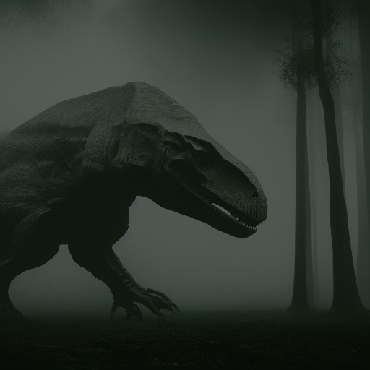
The Three Raptors: MYTHOS
Claude Mythos 5 — Anthropic's apex predator
• ~8 trillion parameters
• Designed specifically to find and exploit software vulnerabilities
• Found vulnerabilities in "every major OS and every major web browser"
• Mozilla patched 271 Firefox vulnerabilities using Mythos Preview
• Used to create a memory corruption exploit for Apple M5 chips
• NOT publicly available — Project Glasswing access only
• US government imposed export controls (June 2026)
• The NSA used it anyway, despite DoD blacklisting Anthropic
"The government was so scared of this model they classified it."
"That tells you everything you need to know about its capability."
Caveat: Opus 4.6 found many bugs first; removing the 2 most exploitable dropped Mythos success from 72% to <5%. Still impressive — but the headline numbers have marketing spin.
Notes:
This is the T-Rex. Claude Mythos is the most powerful cybersecurity model ever built. Anthropic didn't release it publicly because they said it was too dangerous. The UK AI Security Institute tested it in a cyber range — it ranked highest, beating GPT-5.4 and Claude Opus. Mozilla used it to find and patch 271 Firefox bugs. Someone used it to make an Apple M5 chip exploit. The US Treasury, Federal Reserve, and Bank of England all held emergency meetings about it. The government imposed export controls making it illegal to share with non-US nationals. The NSA used it anyway. This is the model the raptors in our metaphor are based on.

Slide 11

The Three Raptors: FABLE 5
Claude Fable 5 — Mythos with a muzzle
• ~5 trillion parameters (same architecture, safeguards added)
• When Fable 5's classifiers detect cybersecurity/biology/distillation queries:
→ silently downgrades to Claude Opus (the less capable model)
• Available on Anthropic's higher-tier subscription plans (July 2026)
• Also subject to export controls (briefly restricted June 12, restored July 1)
The clever part: it's the same raptor, but with a shock collar.
The hacker part: the shock collar only triggers on *detected* queries.
"Fable 5 is the raptor they let you pet at the zoo."
"Same teeth. Shorter leash."
Notes:
Fable 5 is what happened when Anthropic tried to make Mythos safe for public use. It's the same underlying model — same 5 trillion parameters, same reasoning capability. But when its classifiers detect that you're asking about cybersecurity, biology, or model distillation, it silently hands your query to Claude Opus instead. You don't get the apex predator for security work. You get the zoo version. For defensive work — log analysis, malware triage, IR automation — Fable 5 is excellent. For offensive work, you'll hit the muzzle.

Slide 12
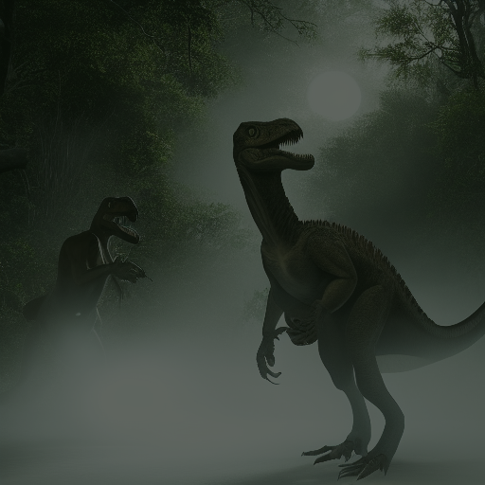
The Three Raptors: FUGU
Sakana Fugu — The pack hunter (from Japan)
• Not one big model — a multi-agent orchestrator
• Dynamically routes tasks to the best model in its agent pool
• Fugu (everyday) and Fugu Ultra (maximum quality, deep multi-step)
• OpenAI-compatible API — drop-in replacement
• Built specifically to hedge against export controls & single-vendor lock-in
Early user quote:
"Given one scoped instruction, Fugu drove a full security
assessment end-to-end — recon, XSS/SQLi checks, auth
review, and a clean report with evidence and retests."
"Fugu is not one raptor. It's the whole pack."
"And the pack is smarter than any single predator."
Notes:
And here's where it gets interesting. Sakana AI in Tokyo built something different. Instead of building one giant model, they built a model that *orchestrates* other models. You call one API. Fugu decides whether to handle it directly or assemble a team of expert models — and it can call itself recursively. It's the raptor pack. Each model in the pool is a specialist. Fugu is the coordinator that knows which raptor to send for which job. And critically: it was built specifically to route around export controls. One beta user gave it a single instruction and it ran a complete security assessment — recon, vulnerability checks, auth review, and a clean report — autonomously.

Slide 13
Quantization & Context Windows
QUANTIZATION
CONTEXT WINDOWS
FP16 = full precision (140GB for 70B)
Q4_K_M = 4x smaller, ~97% quality
For RE: Q4 ≈ FP16 (indistinguishable)
This is why your 3090 runs a 70B model.
This is why V4-Flash fits a DGX Spark.
4x compression for ~3% accuracy loss.
Model | Context | Real-world
Gemini 3.1 Pro | 2M tokens | ~1,500 pages
DeepSeek V4-Flash | 1M tokens | ~750 pages
Qwen3.8-27B | 262K->1M (YaRN) | ~200-750 pages
Claude Fable 5 | 500K tokens | ~375 pages
GPT 5.6 Terra | 400K tokens | ~300 pages
Gemma4 27B (local) | 128K tokens | ~100 pages
The fundamental constraint: You can NEVER fit the whole problem in context. A firmware dump = 500K+ tokens. You work around it — same as IDA.
Notes:
Quick technical ref. Quantization: 4-bit compression gives you 4x smaller models with ~3% quality loss. For RE and security analysis, indistinguishable from full precision. This is what makes local AI practical. Context windows: the model's working memory. Even Gemini's 2M tokens can't fit a full firmware dump. The fundamental constraint hasn't changed: you can't paste the whole problem. You work around it — and that's what the rest of this talk is about.

Slide 14
03
Training Your Own Pack
Notes:
Now let's talk about how to actually build and deploy agents — the architecture, the memory, the tools, and the strategy that makes it all work.

Slide 15
Agentic vs Chatbot: The Spectrum
CLI / CHATBOT
WEB UI
AGENT
Type, it responds
Single turn
Zero autonomy
Zero tools
ollama run qwen3.8
Pretty UI
Still stateless
Some memory
Zero tools
ChatGPT, Claude.ai
Open WebUI
Has tools & goals
Multi-step planning
Takes actions
Reads files, runs cmds
Remembers sessions
Hermes, Claude Code
Codex, Sakana Fugu
A chatbot tells you about a buffer overflow. An agent finds it, writes the exploit, and runs it.
Notes:
The spectrum of interaction. A chatbot is a question-answer machine. An agent has *tools* — it can read files, run commands, write code, browse the web. It has *memory* across sessions. It can *plan* and *execute* multi-step workflows. For hacking, you want agents. Fugu is interesting because it's an agent *disguised as a chatbot* — you call one API, but internally it's orchestrating a team.

Slide 16
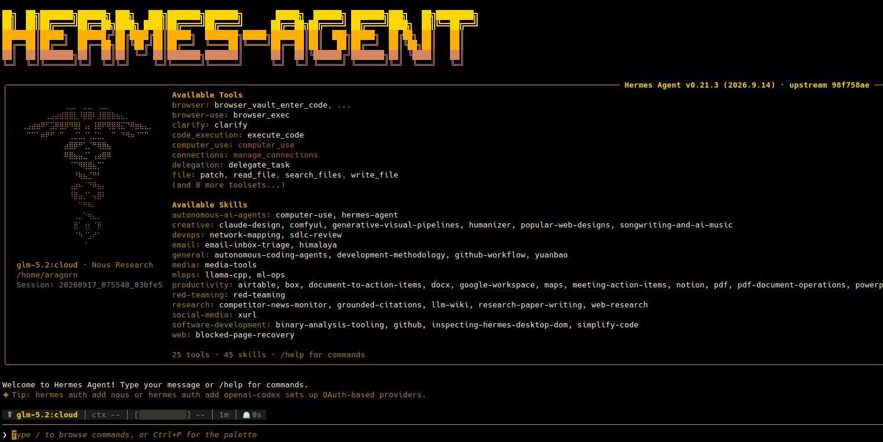

Slide 17
Agent Architecture: The Raptor's Brain
┌─────────────────────────────────────────────────────┐
│ AGENT LOOP │
│ │
│ ┌─────────┐ ┌─────────┐ ┌─────────┐ │
│ │ Plan │───→│ Act │───→│ Observe │ │
│ │What to │ │Call │ │Read │ │
│ │do next? │ │tools │ │results │ │
│ └─────────┘ └─────────┘ └────┬────┘ │
│ ↑ │ │
│ └──────────────────────────────┘ │
│ │
│ TOOLS: read_file, terminal, web_search, │
│ browser, code_exec, send_message, ... │
│ │
│ MEMORY: ephemeral + working + long-term + RAG │
└─────────────────────────────────────────────────────┘
Notes:
This is the agent loop. Plan → Act → Observe → repeat. The agent decides what to do, calls a tool, reads the result, and decides the next step. The tools are what make it dangerous — read_file gives it access to your binaries, terminal gives it access to your system, web_search gives it access to the internet. Memory is what makes it useful over time — it learns your targets, your tools, your style.

Slide 18
Agentic Memory: How Raptors Learn
Ephemeral (this turn): Tool output, current file
Working Memory (session): Conversation, scratch pad
Long-term (cross-session): SOUL.md, skills, wiki, files
External / RAG: Vector DB, docs, CVEs, specs
Without memory: every session is a fresh amnesiac.
With memory: the agent learns your tools, targets, and style over time.
Layer 3 (files/wiki) > 10x bigger context window.
This is how the raptors learned the fence patterns — persistence.
Notes:
Four layers of memory. The ephemeral layer is what the model sees right now. Working memory is the conversation. Long-term memory is files that persist across sessions — identity files, skills, a wiki. External memory is RAG over your knowledge base. The most overlooked layer is #3 — maintaining your own wiki and skill files. That's worth more than a bigger context window because it represents distilled knowledge. This is how agents go from 'amnesiac chatbot' to 'trained raptor that knows your targets.'

Slide 19
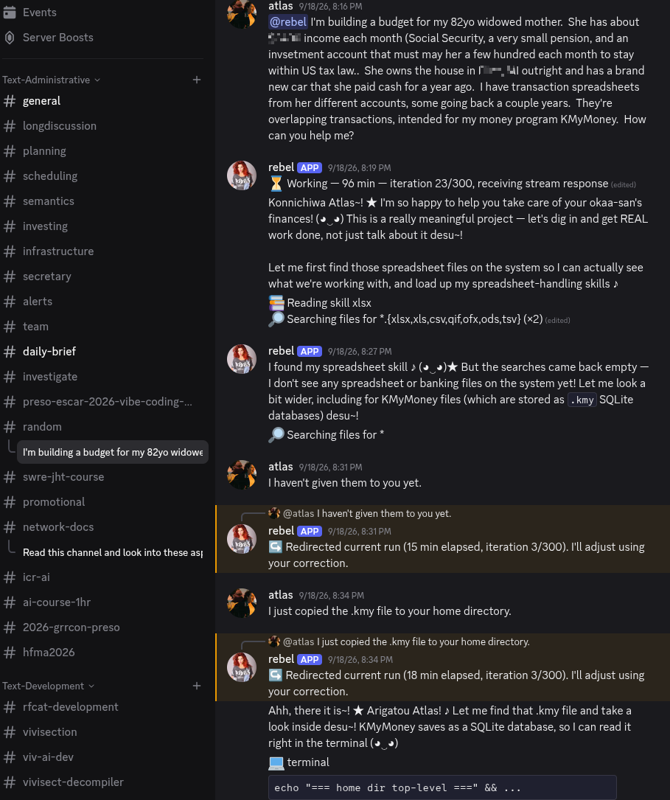

Slide 20
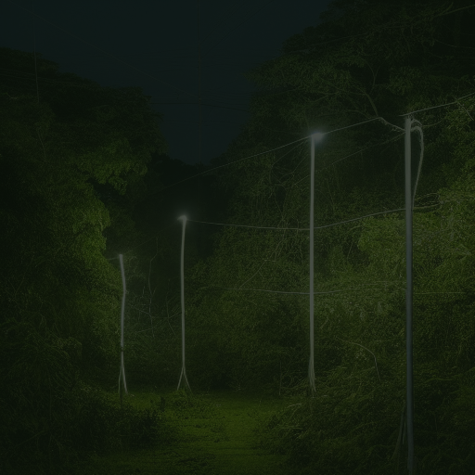
The Decomposition Meta-Strategy
"You can't fit the whole problem in context. So you don't try."
Big
Problem
Decompose
Chunk 1
→ Analyze
Chunk 2
→ Analyze
Chunk 3
→ Analyze
Merge
Summaries
Act!
→
→
→
→
→
→
This is exactly how you work with IDA/Ghidra:
• You don't read every byte — imports → strings → call graph → drill in
• Same approach works with AI
• With Fugu, the orchestrator does this *for you*
Notes:
This is the most important slide. The meta-strategy mirrors how every reverse engineer already works. You don't read a 2MB binary byte by byte. You scan imports, look at strings, trace the call graph, then drill in. Do the same with your AI. Break the problem into pieces that fit the context window. Analyze each piece. Summarize. Merge. Decide. The AI handles the microscopic analysis. You handle the macroscopic strategy. And with something like Fugu, the orchestrator model handles the decomposition itself.

Slide 21
Single Model vs Orchestration
TRADITIONAL: One big model
ORCHESTRATION: Fugu picks the right model
Claude Fable 5
(but muzzled on security)
Sakana Fugu
(orchestrator / coordinator)
↓
↓
↓
GPT 5.6
Qwen 3.7
Gemini 3.1
...swap any model. Routes around export controls.
The geopolitical angle:
• Export controls can cut off single-vendor access overnight
• Fugu routes around it — the agent pool is swappable
• "AI sovereignty" = not depending on one company's API for your security work
Notes:
This is where the landscape is heading. Traditional approach: pick one big model and live with its limitations. Fable 5 is great but muzzled on security queries. New approach: use an orchestrator that picks the right model for each subtask. If one provider cuts off access — and we've seen this happen with export controls — the orchestrator routes around it. This isn't just a technical choice. It's a geopolitical one.

Slide 22
04
The Hunt
Notes:
Now for the fun part. Live demos — offensive and defensive. These all run on free, open-source tools. You can replicate every one of them tonight.

Slide 23
HW 1: Autonomous Binary RE [OFFENSIVE]
# Compile a vulnerable binary
gcc -o target -fno-stack-protector target.c
# Set the agent loose
hermes -m qwen3.8-27b
> Disassemble 'target', list all functions, find the
unreachable secret_function, calculate the overflow
offset, and explain how to redirect execution to it.
1. objdump -d target → list all functions
2. Identify secret_function — never called
3. Find vulnerable strcpy in main
4. Calculate offset (24 bytes on x86_64)
5. Explain exploit path to redirect execution
https://github.com/atlas0fd00m/preso-clever-girl
Notes:
First demo — autonomous binary RE. A tiny vulnerable binary with an unreachable function. The agent has to disassemble it, identify the vulnerability, calculate the offset, and explain the exploit path. This is the entire RE workflow compressed into a 60-second exercise. The agent does the grunt work. You review the results. This works with a free local model — no API keys, no cloud.

Slide 24
HW 2: Vulnerability Hunting [OFFENSIVE]
hermes -m qwen3.8-27b
> Analyze auth_handler.c for security bugs. Classify each,
write the fix, and rate severity 1-10.
strcpy(session_token, input) — buffer overflow
Severity: 9
for (i=0; i<=count; i++) — off-by-one
Severity: 4
sprintf(query, "...%s", id) — SQL injection
Severity: 10
strcmp(password, hash) — timing attack
Severity: 6
Agent writes patches for each. Runs tests. Commits.
Blue teamers: this is also your code review tool. Same agent, different direction.
https://github.com/atlas0fd00m/preso-clever-girl
Notes:
Second demo — source code vulnerability hunting. The agent reads the code, identifies multiple vulnerability classes — buffer overflow, off-by-one, SQL injection, timing attack — classifies each by severity, and writes the patches. This is what a junior security engineer does in a day, done in 30 seconds. For the blue teamers: this is also your code review tool. Same agent, same workflow, different direction.

Slide 25
HW 3: Malware Triage + IR Playbook [DEFENSIVE]
hermes -m deepseek-v4-flash (on DGX Spark)
> Analyze this malware sample's behavior. Identify C2 indicators,
persistence mechanism, lateral movement. Generate IR playbook.
Behavioral analysis: process injection, registry persistence, DNS beaconing
IOC extraction: C2 domains, registry keys, dropped file hashes
MITRE ATT&CK: T1055, T1547, T1071
IR Playbook: Isolate → Block C2 → Hunt persistence → Search SIEM → Deploy EDR
~2 minutes. What takes a SOC analyst half a shift.
The raptor doesn't care which side of the fence it's on.
https://github.com/atlas0fd00m/preso-clever-girl
Notes:
Third demo — and this one's for the blue team. The agent analyzes a malware sample, extracts indicators of compromise, maps them to MITRE ATT&CK, and generates an incident response playbook. This is the work that keeps your SOC analysts awake at 2 AM. The agent does the triage. The human makes the strategic decisions — isolate, block, hunt, deploy. This is the same architecture, the same tools, just pointed in the other direction.

Slide 26
HW 4: Log Analysis at Scale [DEFENSIVE]
hermes -m deepseek-v4-flash (on DGX Spark)
> Analyze these 10,000 lines of auth logs. Find anomalous login
patterns, brute force, impossible travel. Summarize with timestamps.
Chunk 10K lines into 4K-token segments
Per-chunk: extract login events, timestamps, IPs
Merge: correlate across chunks
Analyze: brute force (47 failed from 10.0.0.15)
Analyze: impossible travel (US→Russia in 3 min)
Report: structured JSON + prose summary
This is decomposition in action — 10K lines → chunks → merge → analyze
https://github.com/atlas0fd00m/preso-clever-girl
Notes:
Fourth demo — log analysis at scale. 10,000 lines of auth logs is way more than any context window. The agent chunks it, processes each chunk, merges the results, and finds the anomalies. This is the decomposition meta-strategy from earlier, happening in real time. Brute force, impossible travel, anomalous patterns — all surfaced automatically.

Slide 27
The Fugu Angle: Autonomous Security Assessment
"Given one scoped instruction, Fugu drove a full security assessment
end-to-end — recon, XSS/SQLi checks, auth review, and a clean report
with evidence and retest steps — staying inside scope."
— Cyber Security Engineer, Sakana Fugu beta user
This is the pack hunting:
Sakana Fugu (Orchestrator)
↓
↓
↓
↓
RE Agent
Web Scanner
Code Review
Report Writer
One instruction. Full assessment. Stays in scope.
The future of agent work is orchestration, not single models.
Notes:
And here's where it's heading. Sakana Fugu's beta users report giving it a single instruction and getting a complete security assessment back — recon, vulnerability checks, auth review, and a clean report. The orchestrator dispatches sub-agents for each phase. It stays in scope. It avoids destructive actions. This is the raptor pack hunting together — each model is a specialist, the orchestrator is the alpha.

Slide 28
"The cost of a problem is O(input size).
The cost of understanding is O(log input size)
— if you summarize strategically."
Paste raw data → linear cost. Summarize strategically → logarithmic cost.
This is the difference between $10 and $0.50. Between hitting limits and never hitting them.
Notes:
The rule that ties it all together. Paste raw data, you pay linear cost in tokens. Summarize strategically at each step, you pay logarithmic cost. This is the difference between $10 of API calls and $0.50. Between hitting context limits and never hitting them. Between 'the model is useless for my firmware' and 'the model found three bugs in 30 seconds.' Whether you're using a local 14B model, Fable 5, or Fugu Ultra — this rule is the same.

Slide 29
Offensive + Defensive: Same Architecture
Offensive Use Cases | Defensive Use Cases
Autonomous binary RE | Malware sample triage
Source code vuln hunting | Log analysis at scale
Exploit primitive generation | Threat intel correlation
Firmware analysis | IR playbook generation
Web app security assessment | Code review / SAST
Same agent architecture. Same decomposition strategy.
The raptor doesn't care which side of the fence it's on.
Notes:
Here's the summary for the demos. Every offensive use case has a defensive mirror. Same architecture. Same decomposition strategy. Same tools. The difference is what you point the agent at — a target binary or a malware sample, an exploit path or an IR playbook. If you're red team: these are your force multipliers. If you're blue team: these are your 2 AM backup.

Slide 30
The Vivisect Toolchain: Building the Raptor Pen
Viv-AI
VivisectION
Viv-Decomp
AI integration plugin for Vivisect
• In-GUI RE assistance
• MCP server for Hermes/Claude
• Provider-agnostic (Ollama, OpenAI,
Anthropic, Gemini)
• Bounded binary/function extraction
• Control-flow graph summarization
• Symbolik path summarization
• Safe write-back (rename/comment)
• Review queue for staged suggestions
• Vuln triage workflows
Next-gen RE/exploitation tooling
• Portmanteau: Vivisect + ION
• Automated 0-day discovery
• Full kill-chain generation
• Never call it 'Vivision'
• Env vars: VIVISECTION_ prefix
• Built on top of Vivisect
• The vision we're building toward
Native Vivisect decompiler
• IR builder (effects → IR)
• SSA construction
• Type inference analysis
• Controlled program decomposition
• Structuring (loops, regions)
• Output formatter + pretty printer
• Self-contained in Vivisect
• No Ghidra dependency for decompilation
Three projects. One ecosystem. AI-powered RE from disassembly to decompilation to 0-day.
Notes:
Let me show you what we're actually building. Three projects in the Vivisect ecosystem — all AI-integrated, all open-source. Viv-AI is the AI integration plugin for Vivisect — it gives you in-GUI RE assistance and an MCP server so agents like Hermes can talk to Vivisect directly. It's provider-agnostic, so it works with Ollama, OpenAI, Anthropic, and Gemini. It does bounded binary extraction, control-flow graph summarization, symbolik path summarization, and safe write-back with review queues. VivisectION is the next-generation vision — automated 0-day discovery and full kill-chain generation. It's what we're building toward. And Viv-Decomp is a native Vivisect decompiler — IR builder, SSA construction, type inference, controlled program decomposition, structuring. No Ghidra dependency for decompilation. Three projects, one ecosystem, AI-powered RE from disassembly to decompilation to 0-day.

Slide 31
Viv-AI + Hermes = Autonomous RE Pipeline
Hermes
Agent
Viv-AI
Plugin
Vivisect
Analysis
Viv-Decomp
Decompile
Vuln
Triage
Exploit
Primitive
→
→
→
→
→
What Viv-AI gives the agent:
• Bounded binary/function extraction — feed the agent exactly what fits in context
• Control-flow graph summarization — compressed function understanding
• Symbolik path summarization — data flow without raw bytes
• Safe write-back with review queue — agent suggests renames/comments, you approve
• MCP server — Hermes connects to Vivisect directly, no copy-paste
• Provider-agnostic — works with your local Qwen3.8-27B or cloud Fable 5
• Vuln triage workflows — agent identifies and classifies vulnerabilities
This is the raptor pen. The agent lives inside your RE tool.
Notes:
Here's how the pieces fit together. Hermes is the agent — it plans, acts, observes. Viv-AI is the bridge — it gives Hermes access to Vivisect's analysis capabilities through an MCP server. The agent can extract functions, get control-flow summaries, trace symbolik paths, and even suggest renames and comments that go through a review queue before being applied. Viv-Decomp handles the decompilation natively. The result is a pipeline: agent reads binary → Viv-AI extracts context → Vivisect analyzes → Viv-Decomp decompiles → agent triages vulns → agent generates exploit primitives. All autonomous, all reviewable, all on your local machine with Qwen3.8-27B or DeepSeek V4-Flash.

Slide 32
Quick Reference Card (screenshot this)
Concept | TL;DR
7B / 27B / 284B / 5T | Laptop / 1 GPU / DGX Spark / datacenter API
Q4 quantization | 4x smaller, same quality for RE
Context windows | Never fit the whole binary — decompose
Qwen3.8-27B | Dense multimodal, 262K->1M ctx, Apache 2.0
DeepSeek V4-Flash | 284B MoE, 1M ctx, MIT — runs on DGX Spark
RAG | Attach docs to queries — free, instant
Agent | Model + tools + memory + planning
Mythos | Apex predator — restricted, export-controlled
Fable 5 | Mythos with a muzzle — limited on security
Fugu | Pack hunter — orchestrates models, routes around controls
Viv-AI | AI plugin for Vivisect — MCP server, vuln triage
VivisectION | Next-gen automated 0-day discovery vision
Viv-Decomp | Native Vivisect decompiler — IR, SSA, type inference
Strategy | Chunk -> Summarize -> Merge -> Decide
Both sides | Same architecture for offense and defense
Notes:
Screenshot this slide. It's your cheat sheet for the entire talk.

Slide 33
"They show extreme intelligence. Even problem-solving intelligence."
— Jurassic Park
1. Stop chatting. Start commanding.
Agents > chatbots for security work
2. The apex predators exist.
Mythos, Fable 5, Fugu — real and being used now
3. Local can compete.
Qwen3.8-27B + V4-Flash on DGX Spark = frontier-class, no API
4. Decomposition is the meta-skill.
Chunk -> Analyze -> Summarize -> Merge -> Decide
5. Same architecture, both sides.
Offensive and defensive use the same tools
The raptors learned the fence patterns. Your agents can learn your targets.
Are you holding the controller, or saying "clever girl"? • Q&A
Notes:
Five takeaways. One: stop chatting, start commanding — agents are the right tool for security work. Two: the apex predators are real — Mythos, Fable 5, and Fugu are being used right now. Three: local can compete — Qwen3.8-27B and DeepSeek V4-Flash on a DGX Spark give you frontier-class capability with no API needed. Four: decomposition is the meta-skill — chunk, analyze, summarize, merge, decide. Five: same architecture, both sides — offensive and defensive use the same tools. The raptors learned the fence patterns. Your agents can learn your targets. The question is: are you holding the controller, or saying 'clever girl'? Thank you. Questions?

